Slide 1
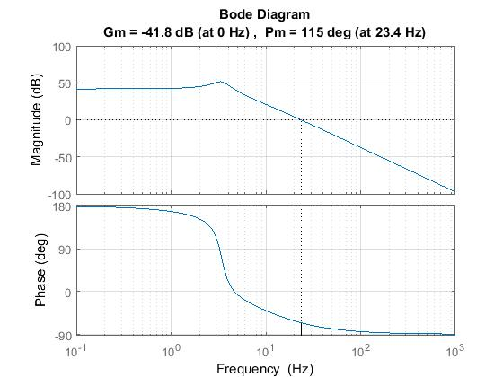
Loopshaping
3Hz
Poles coming from the cart dynamics.
We would like to cancel this behavior.

Slide 2
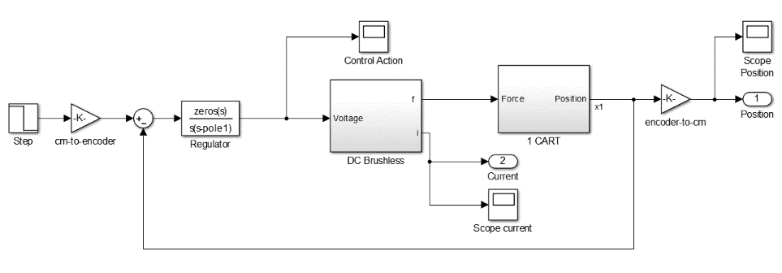
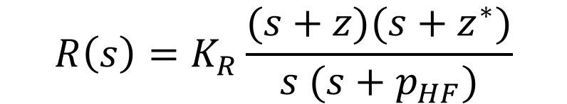
Loopshaping
cancel out cart dynamic
$$R\left(s\right)=K_{R}\frac{(s+z)(s+z^{∗})}{s (s+p_{HF})}$$
Integral action
causal block

Slide 3
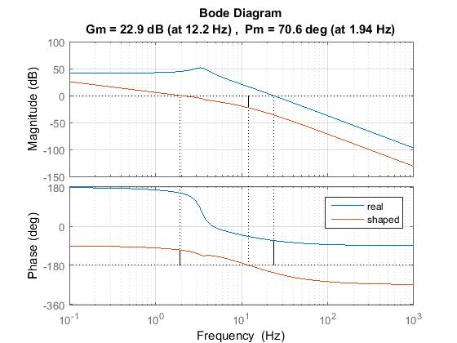
Loopshaping

Slide 4
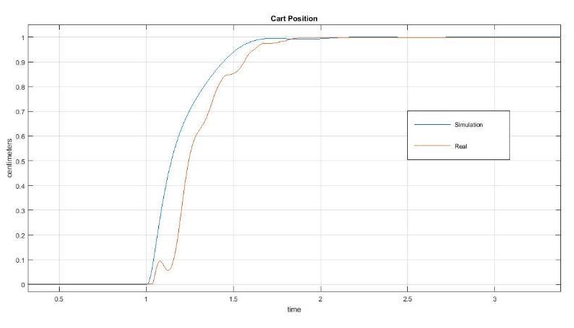
Loopshaping
Transient does not take into account non-linearities,
but rising time and steady-state value match what we expected.

Slide 5
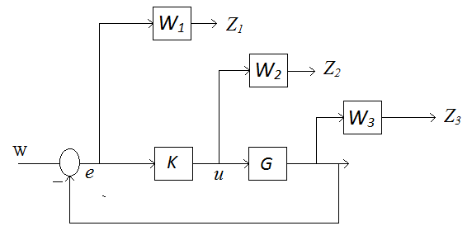

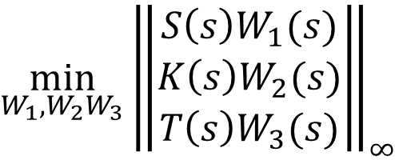
$$H_{∞}$$
$$\min_{W_{1},W_{2}W_{3}}{{\left\|\begin{aligned}S\left(s\right)W_{1}(s) \\ K\left(s\right)W_{2}(s) \\ T\left(s\right)W_{3}(s)\end{aligned}\right\|}_{∞}}$$

Slide 6
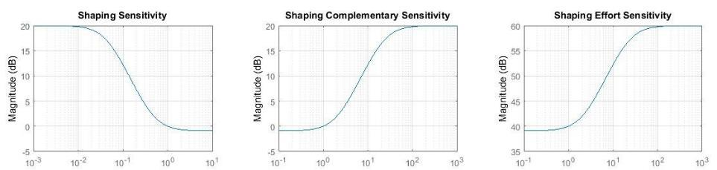
$$H_{∞}$$
1Hz
The weights should have the inverse shape of the desired sensitivity.
The higher the weight the weaker the control action:
It is important since the motor saturates at ±5V.

Slide 7
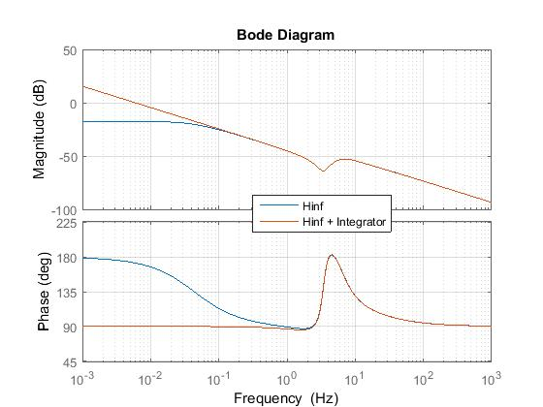
$$H_{∞}$$

Slide 8
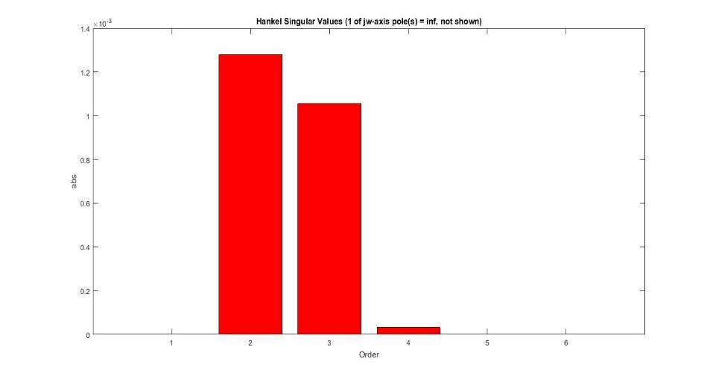
$$H_{∞}$$
Reducing the order of complexity of the regulator does not alter perfomance.

Slide 9
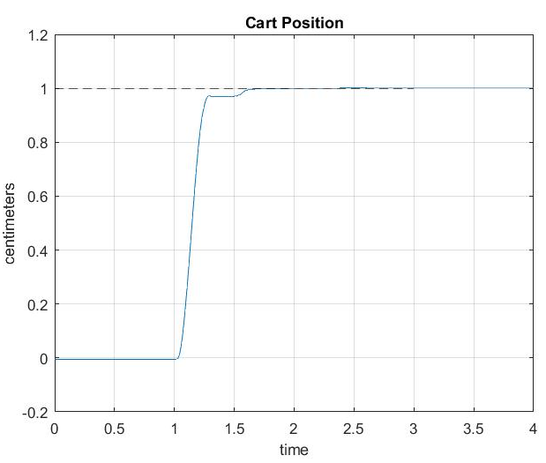
$$H_{∞}$$
Zero tracking error
Rising time less than 1 sec
Noise cancellation

Slide 10
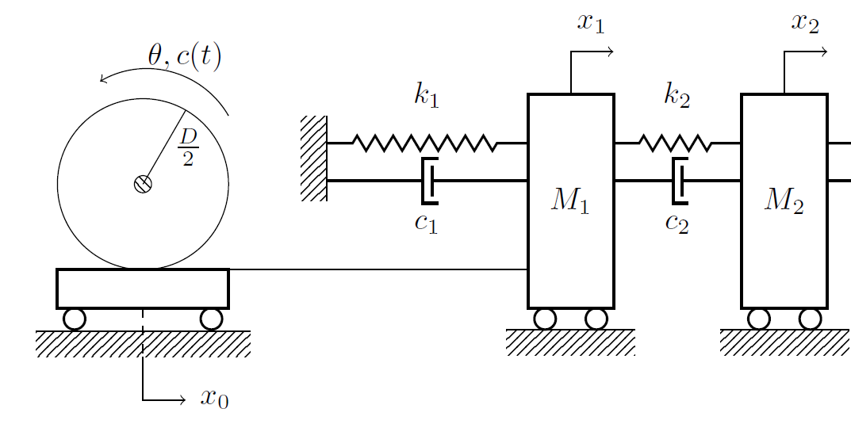
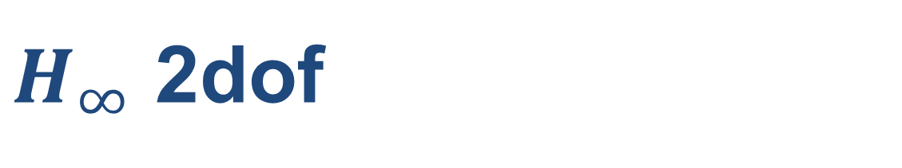
$H_{∞}$ 2dof

Slide 11
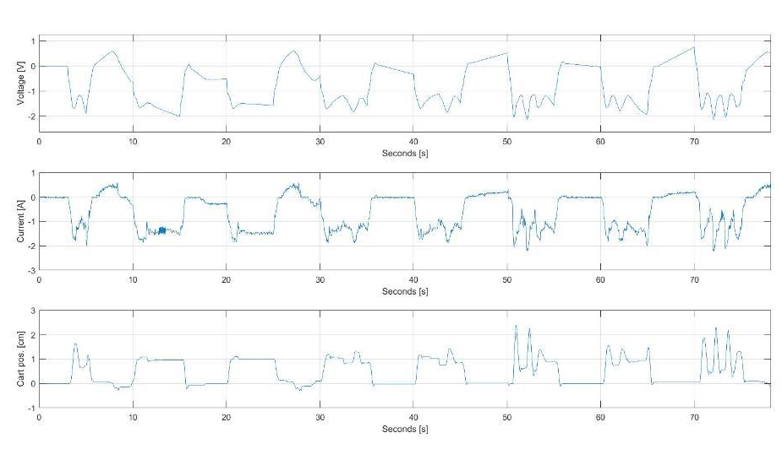
$H_{∞}$ 2dof

Slide 12
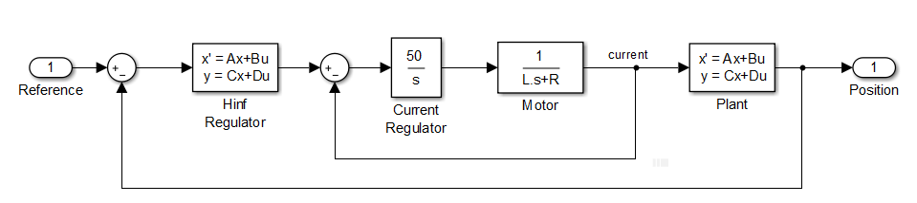
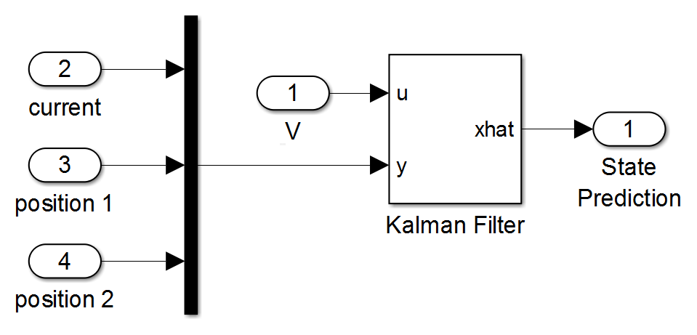
$H_{∞}$ 2dof
The current is not directly measured, but estimated through a Kalman filter.
The current regulator allows to stabilize the motor effort.

Slide 13
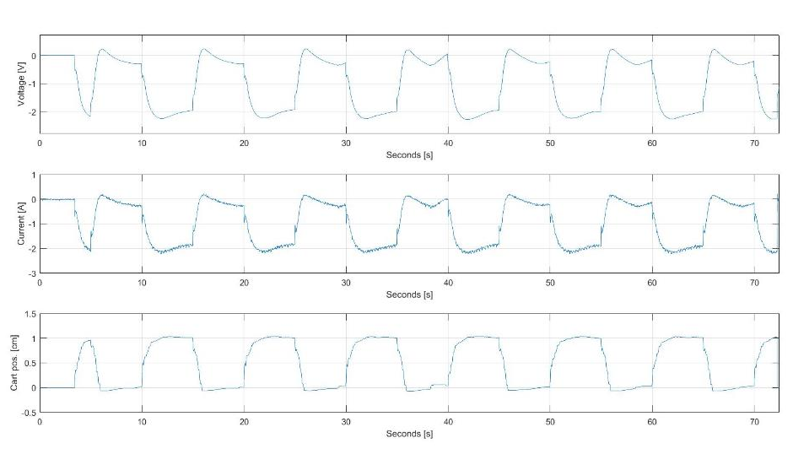
$H_{∞}$ 2dof

Slide 14
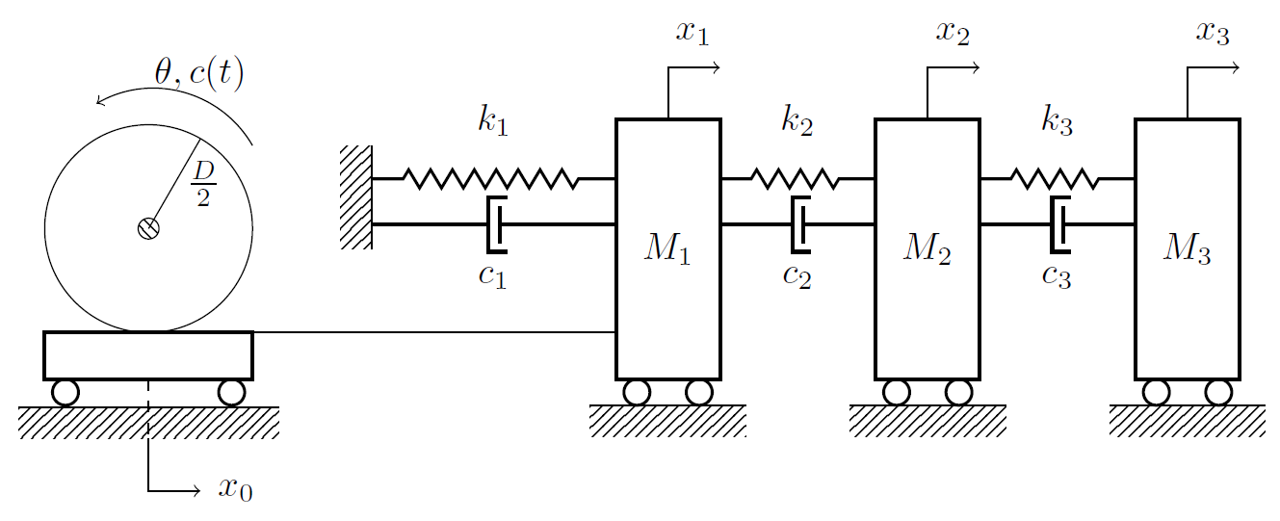
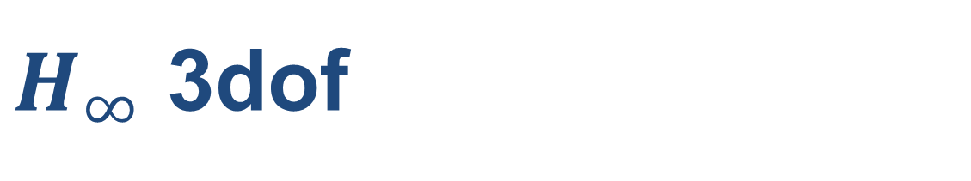
$H_{∞}$ 3dof

Slide 15
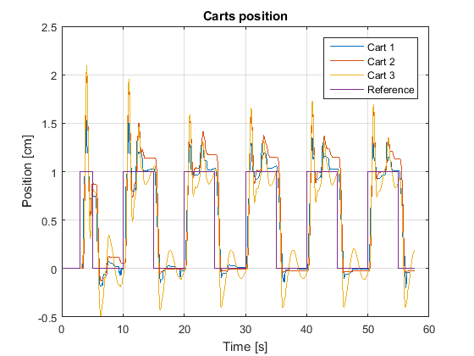
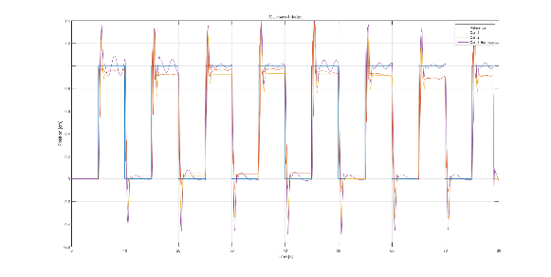
$H_{∞}$ 3dof

